Slide 1
Lab 3 Introduction to c++ stl
DEE 1319
Department of Electronics Engineering
National Chiao Tung University

Slide 2
Introduction
Standard Template Library (STL)
STL is a set of C++ template classes to provide common
programming data structures and functions.
such as lists, stack, arrays, etc.
STL has four components:
Algorithms (sorting, searching, etc)
Containers (stacks, queue, vector, etc)
Functions
Iterators

Slide 3
Algorithm
The header algorithm defines a collection of functions especially designed to be used.
They act on containers and provide means for various operations for the contents of the containers.
Example
Sorting
Searching
STL algorithms

Slide 4
Generic Algorithms
Basic template functions
Algorithm definition revisited:
Set of instructions for performing a task
Can be represented in any language
Typically thought of in ‘pseudocode’
Considered ‘abstraction’ of code
Gives important details, but not find code details
STL’s algorithms in template functions
Guaranteed that they are as fast as possible

Slide 5
Containers
Container classes in STL
Different kinds of data structure
Like vector, list, stack, queue
Container classes store objects and data.
Each is template class with parameter for particular data type to be stored
Ex: lists of int, double or myClass types
Each container has its own iterator.
Even though they are used similarly.
One might have bidirectional, another might just have forward iterators

Slide 6
Iterators
‘Abstraction’ of iterators
Designed to hide details of implementation
Provide uniform interface across different container classes
Using overloaded operators:
++, --, ==, !=, *
If p is iterator variable, *p gives access to data pointed to by p
vector template class
Also has members begin() and end() c.begin(); //Returns iterator for 1st item in c c.end(); //Returns ‘test’ value for end

Slide 7
Iterator Classifications
Forward iterators:
++ works on iterator
Bidirectional iterators:
Both ++ and -- work on iterator
Random-access iterators:
++, --, and random access all work with iterator
These are ‘kinds’ of iterators, not types!

Slide 8
Cycling with Iterators
Cycling ability using for loop: for (p = c.begin() ; p! = c.end() ; p++) process *p //*p is current data item
Keep in mind
Each container type in STL has own iterator types
Even though they’re all used similarly

Slide 9
vector Iterator Types
Iterators for vectors of ints are of type: std::vector<int>::iterator
Iterators for lists of ints are of type: std::list<int>::iterator
Vector is in std namespace, so we need: using std::vector<int>::iterator;

Slide 10
Constant and Mutable Iterators
Dereferencing operator’s behavior dictates
Constant iterator:
* produces read-only version of element
Can use *p to assign to variable or output, but cannot change element in container
E.g.: *p = <anything>; is illegal
Mutable iterator:
*p can be assigned value
Changes corresponding element in container
i.e.: *p returns an lvalue

Slide 11
Example: Vector
“vector” in STL can be used as an enhanced alternatives of array, and supports lots of operations that array can’t easily accomplish.
#include<vector>

Slide 12
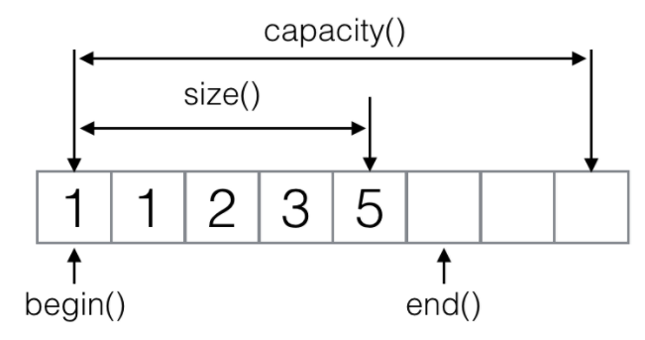
vector(1/7)

Slide 13
vector(2/7)
Common used function for vector
Function
v.empty() | Check if v is empty
v.clear() | Clear all elements of v
v.size() | Get the size of v
v.push_back() | add element at the end
v.pop_back() | Delete last element
v.resize() | Resize the vector
v.front() | Return the first value of v
v.back() | Return the last value of v
v.assign(v1, v1+5) | Copy first 5 elements from v1 to v

Slide 14


vector(3/7)
Declaration
You can declare vector with any types, like int, char, or even class which you define yourself.
If you declare a class named ‘test’, you can also use it on your declaration of vector.
vector<int> v(5,0); → v=[0,0,0,0,0]

Slide 15
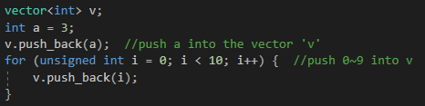
vector(4/7)
push_back
You can push variables into vector with push_back() function.
After push a, v contains: 3
After push 0~9, v contains: 3 0 1 2 3 4 5 6 7 8 9

Slide 16

vector(5/7)
Two ways for loop
Use iterator to search
Ans:

Slide 17

vector(6/7)
Two ways for loop
Use index to search
Ans:

Slide 18
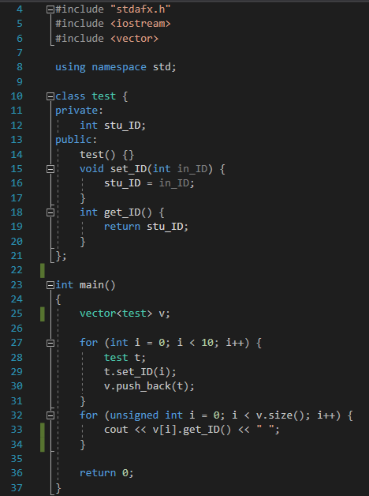
vector(7/7) --example code
result:

Slide 19


Sort(1/3)
#include<algorithm>
sort(v.begin(), v.end())
v: 5 4 3 2 1 0
v : 0 1 2 3 4 5

Slide 20



Sort(2/3)
sort(v.begin(), v.end(), myfunc)
myfunc is a bool function
v: 0 1 2 3 4
v: 4 3 2 1 0

Slide 21
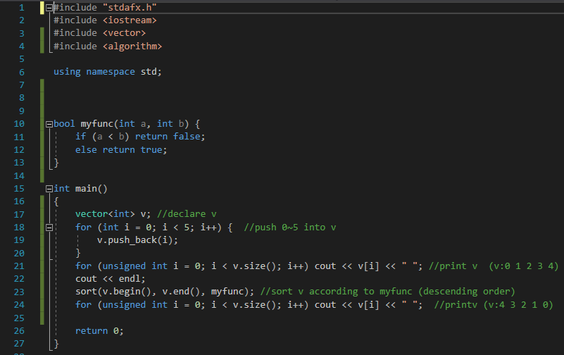
Sort(3/3) --example code

Slide 22
Lab Exercise(1/3)
In every step, you need to input two variables, first one is a control character, and the other one is an integer number.
Print the result number sequence and total size after each step, and stop until read control character ‘z’.
If the input character is not in the following list, print”Your command is not supported, please input again”

Slide 23
Lab Exercise(2/3)
Control character | Motion
i | Push the number to last
d | Delete last element (no need to input number)
c | Clear the sequence (no need to input number)
s | Sort the sequence (input number : 0:ascending order) 1:descending order
r | Resize the sequence (the number next is the size that you want to resize)
z | stop

Slide 24
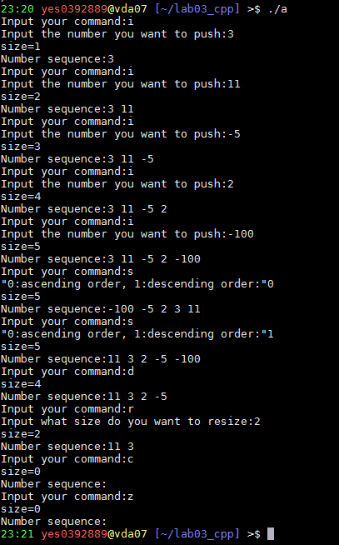
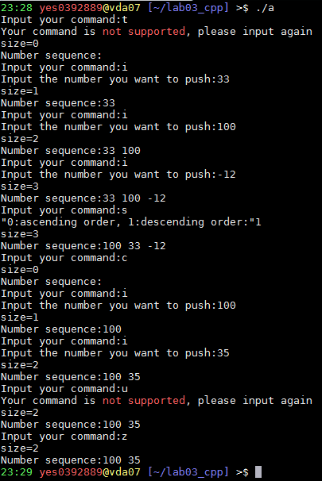
Lab Exercise(3/3)

Slide 25
HW(1/2)
Input students’ ID, weight(kg) and height(m) until read -1. (Interger: ID ; Double: height, weight)
Use class to store the data, and calculate their BMI.
Use sort function to sort the classes in vector with BMI in ascending order.
#include <iomanip>, use the functions in this header to round off the data to the 2nd decimal place and output it. (hint:precision)
Upload your code named “hw3.cpp” to e3
There will be 0 point if your ouput form is not the same as the example.
(Hint: use myfunc() in sort() to sort the class vector )

Slide 26
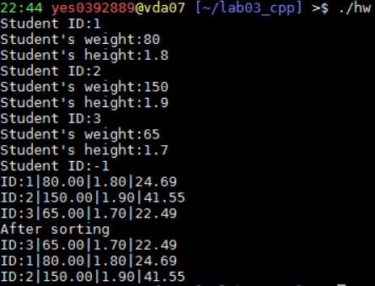
HW(2/2)
Input
Output

Slide 27
Reference
C/C++ - Vector (STL) 用法與心得完全攻略
http://mropengate.blogspot.tw/2015/07/cc-vector-stl.html
Cplusplus.com std::vector
http://www.cplusplus.com/reference/vector/vector/
Sort
http://www.cplusplus.com/reference/algorithm/sort/
Iomanip
http://www.cplusplus.com/reference/iomanip/

